Slide 1
CRFS 2005 – 2022 Black & Copper Rockfish Estimates
Ashok Sadrozinski
12/21/2022

Slide 2
CRFS 2005 – 2022 Black & Copper Rockfish Estimates
• Southern CA = CRFS Districts 1 & 2 (south of Point Conception)
• Northern CA = CRFS Districts 3 – 6 (north of Point Conception)
• Estimated effort (angler trips) & catch (numbers of fish)
• Effort estimated by trip-type (Bottomfish) not individual species
• CPUE is calculated for individual species
• Catch = Effort X CPUE

Slide 3
Factors Potentially Affecting CRFS Estimates
• Chapter 7 of the CRFS Methods Document describes historical changes to the surveys.
• The Angler License Directory Telephone Survey (ALDTS) is used to estimate PR private-access and night fishing effort.
• From 2004 – 2010 the ALDTS sampling frame was the Angler Licensee Database (ALDB) which contained license data based on sales from cooperating license vendors.
• Since 2011 ALDTS has used the Automated License Data System (ALDS) complete list of current California fishing licenses for a more complete and less biased frame.
2008 – CRFS amended ALDTS estimates for PR private-access and night fishing effort, described in detail in the CRFS methods document.

Slide 4
(More) Factors Potentially Affecting CRFS Estimates
2011 – PC effort estimates switched from a telephone survey of PC operators to using PC logs to estimate effort.
2014 – PR2 sites stratified by effort level to increase sampling efficiency & precision – likely minimal effect on overall groundfish estimates because only ~ 10 percent of fishing effort occurs at PR2 sites.
2015 – CDFW began applying depth-dependent mortality estimates, PSMFC applied depth-dependent mortality estimates for prior years.
2020 – No estimates April – June due to COVID-19.
2022 – Estimates described in this presentation include January through September.

Slide 5
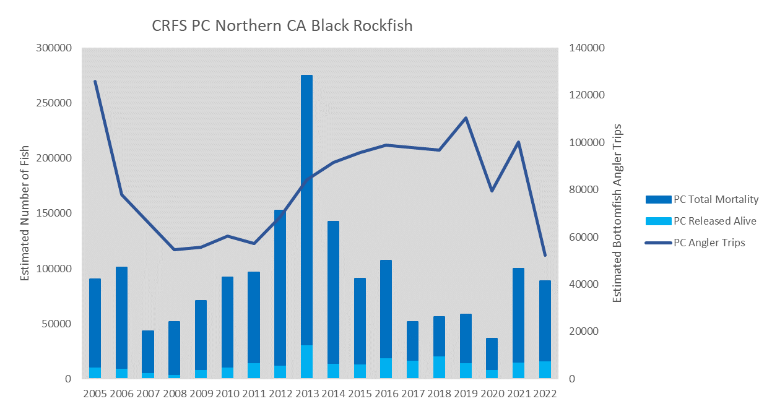
Notes:
The PC effort estimates switched in 2011 from a telephone survey of PC operators to using PC logs to estimate effort.
The elevated catch that peaked in 2013 appears somewhat independent of effort (i.e., higher CPUE in 2013).
Groundfish Project staff jump in with any information regarding regulation changes, recruitment events or other information to explain the trends.

Slide 6
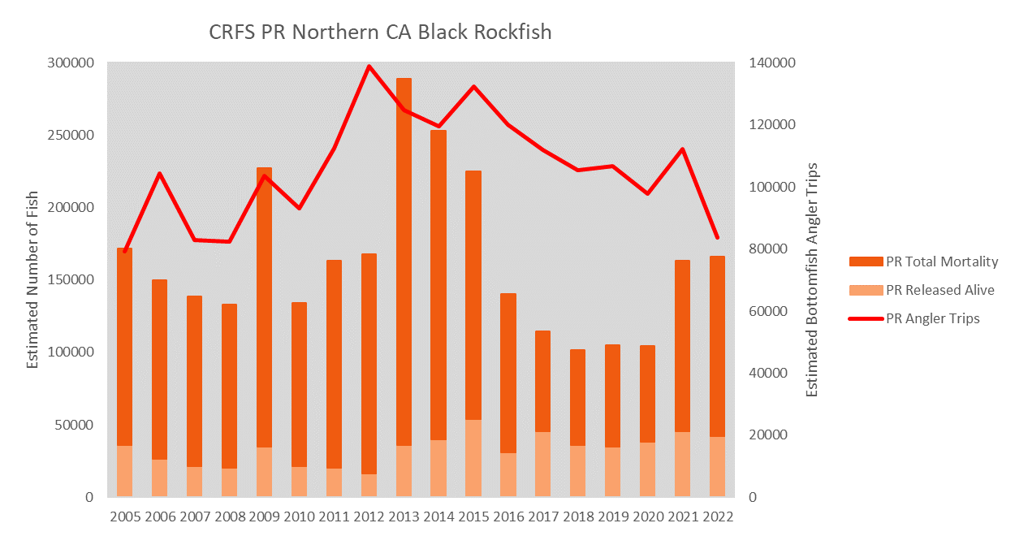
Notes:
Elevated catch peaking in 2013 as with PC mode.

Slide 7
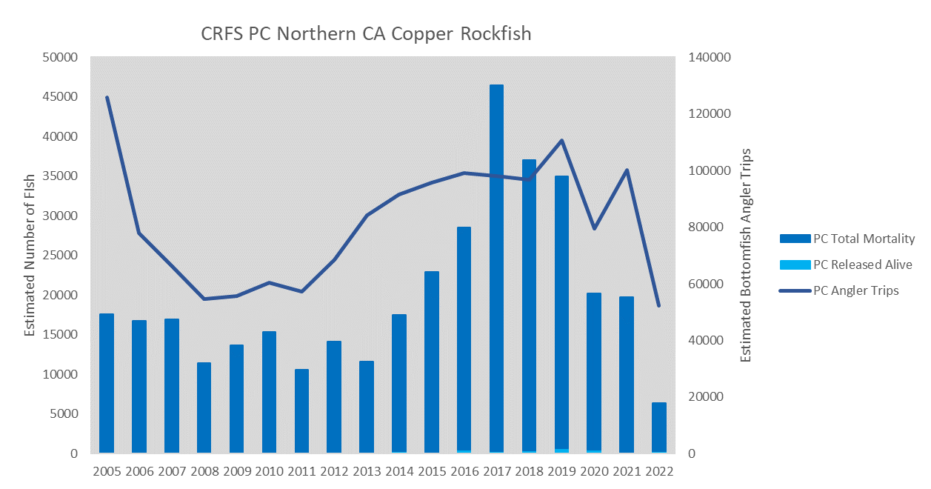
Notes:
Catch peaked in 2017.

Slide 8
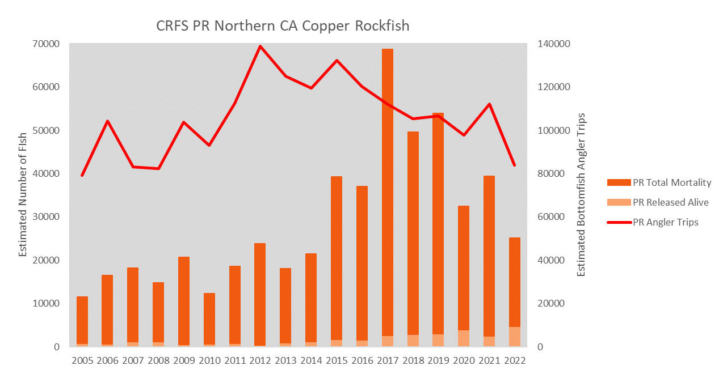
Notes:
Again catch peaked in 2017.

Slide 9
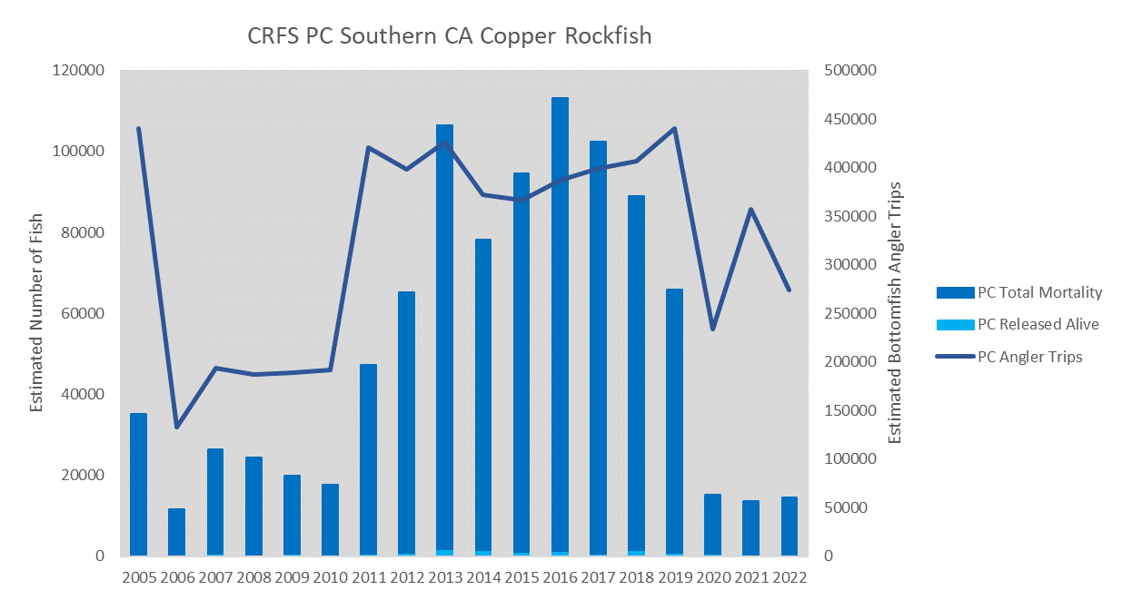
Notes:
Elevated effort & catch 2011- 2019. As mentioned the PC effort estimate methods changed in 2011.

Slide 10
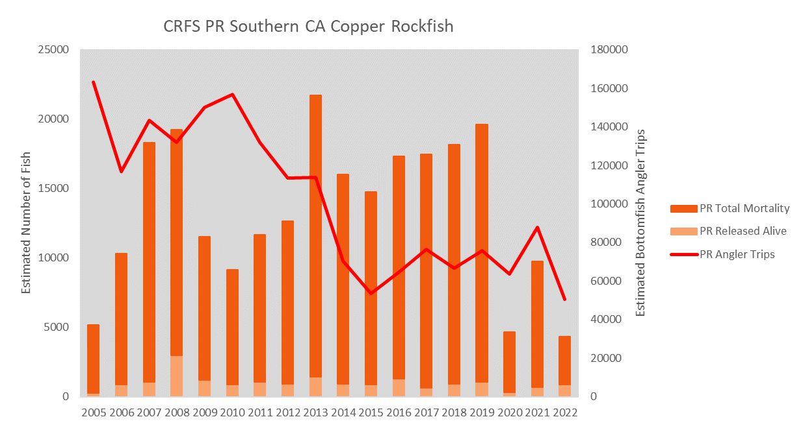
Notes:
High effort & catch 2007 & 2008. Also elevated catch for much of the same period as seen for PC, but coinciding with decreased effort.

